Slide 1

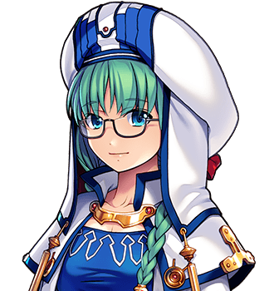
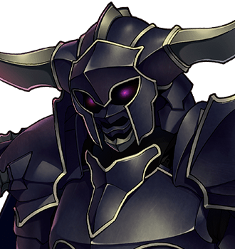
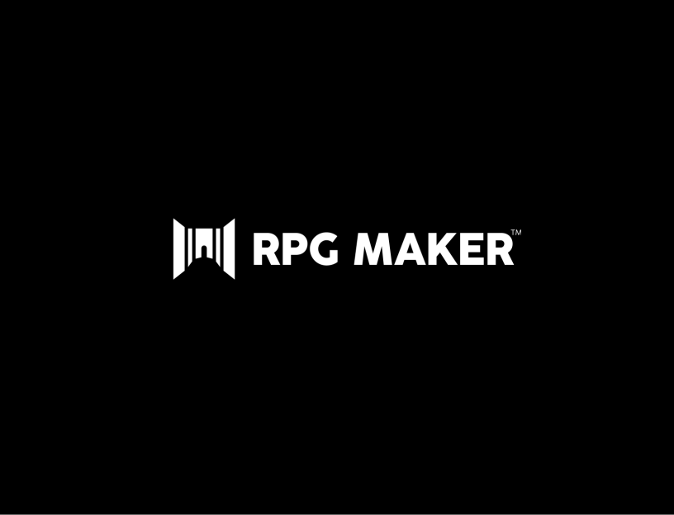

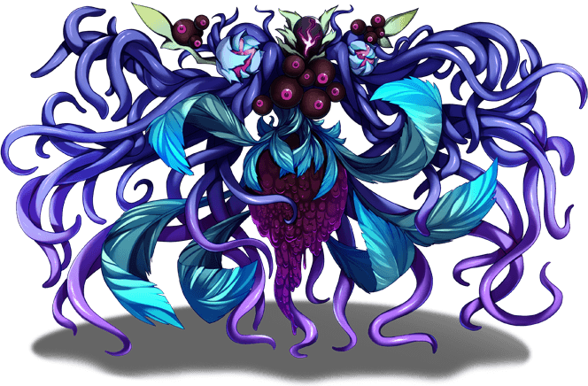

CSC 4821/6821 Fall 2025
Final Project
Professor Weeks
Due date : Dec 10 2025
Journey To The Unknown
Developed by Sunwoo Yeom
Notes:
Hello, I’m Sunwoo Yeom. Welcome to my project, Journey To The Unknown.

Slide 2
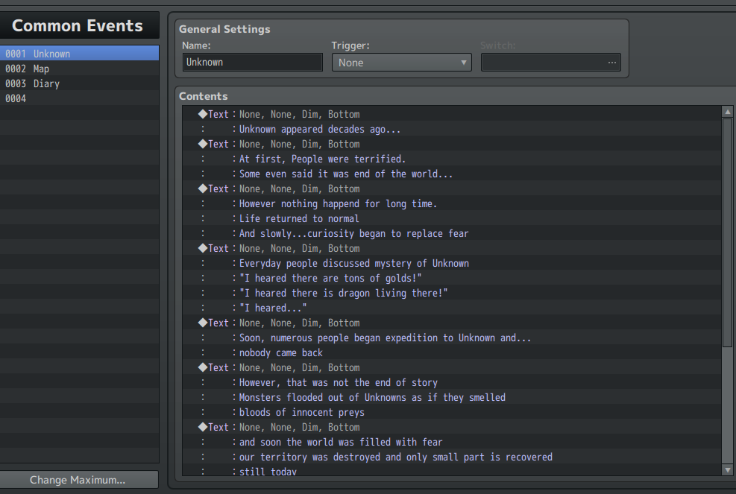
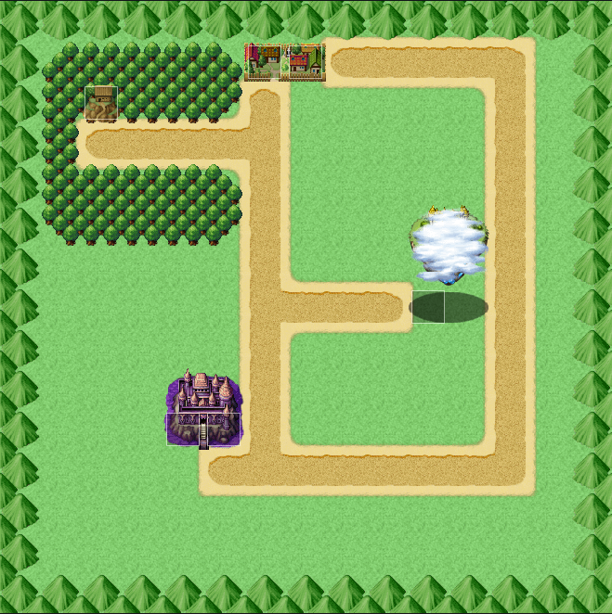
Background Information
2D RPG Game
World (Pokemon)
Story Focused
Different Endings (Legend of Mortal)
Different difficulty depending on your choices (Legend of Mortal)
Storyline
Decades ago, mystery object called Unknown appeared.
From them, monstered flooded and the world fell.
Heroes tried yet they only could decrease the attack.
Newton, main character, starts his journey to solve mystery surrounding Unknown, and ultimately save world from evils.
Notes:
Starting with background information, Journey to the Unknown is 2D RPG Game. The world is motivated by pokemon, where you can freely travel between maps, but to do certain actions, you need to beat gym leader. Here in Unknown, you have to complete quest and beat boss to progress the story. It is story focused game, where it has different endings, and different level of difficulties, all influenced by users choices. This is motivated by Legend of Mortal. Quick Storyline is that…

Slide 3
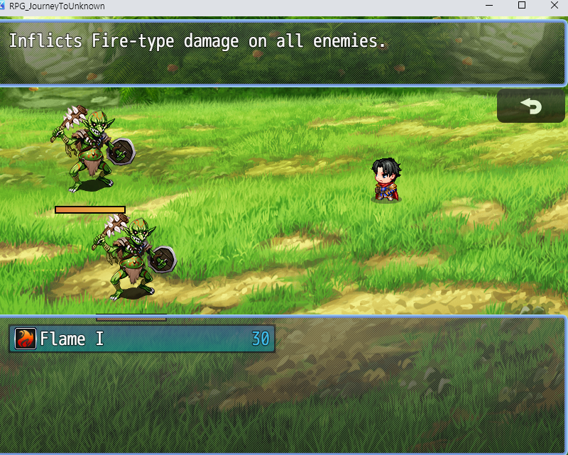
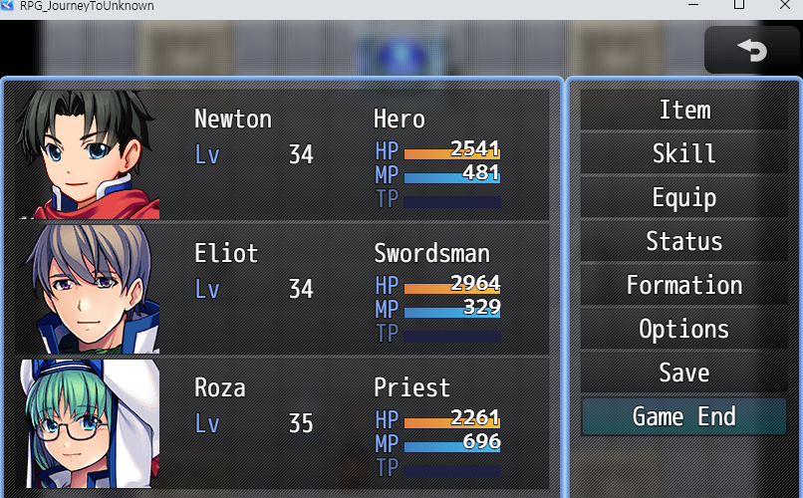
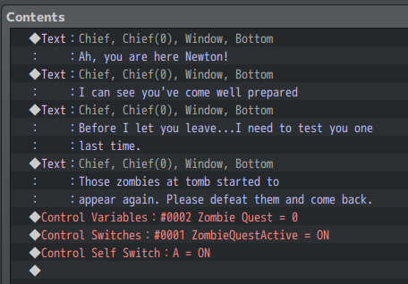
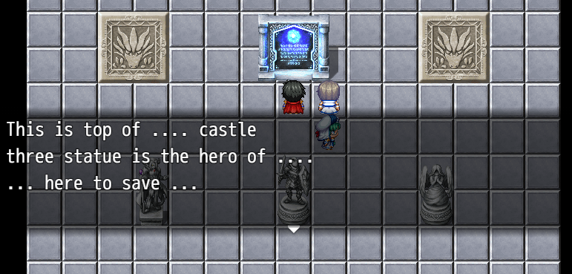
Game Fundamentals
RPG Maker
Turn Based Combat
Complete Quests to progress to next chapter
Interact with NPCs and Objects to find hidden info
Find bed to rest and save
Notes:
I used RPG Maker MZ as game engine. It is turn based combat. Main way to play the game is to follow along the quests and interact with npcs and objects to find hidden info about main story.

Slide 4
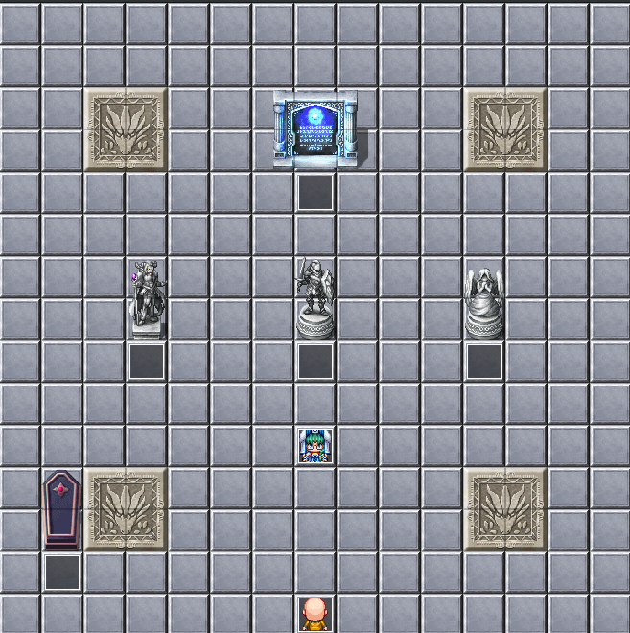
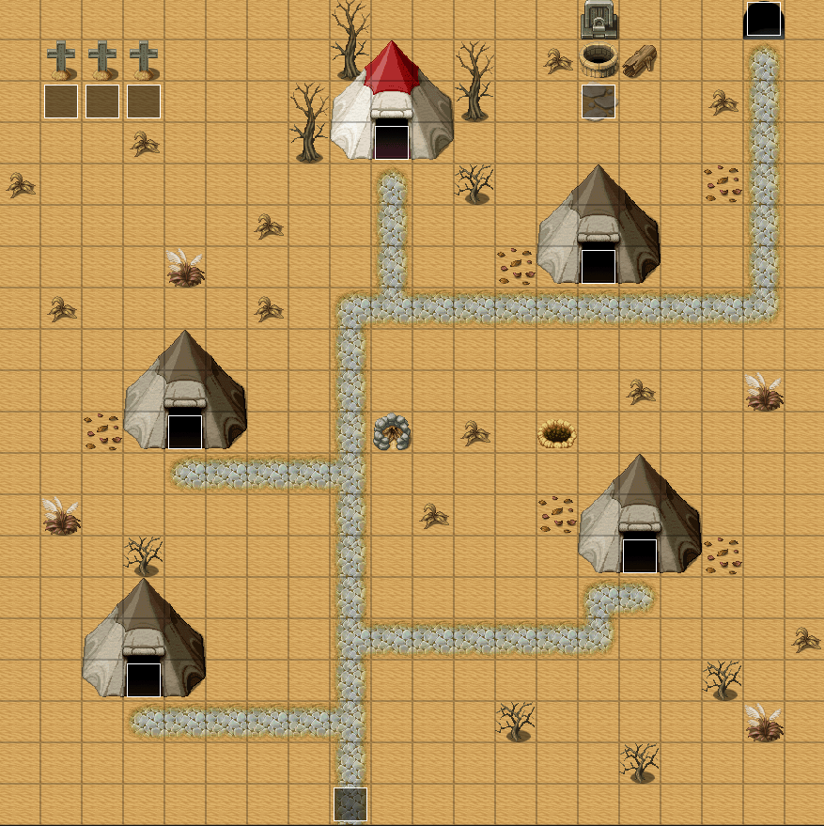
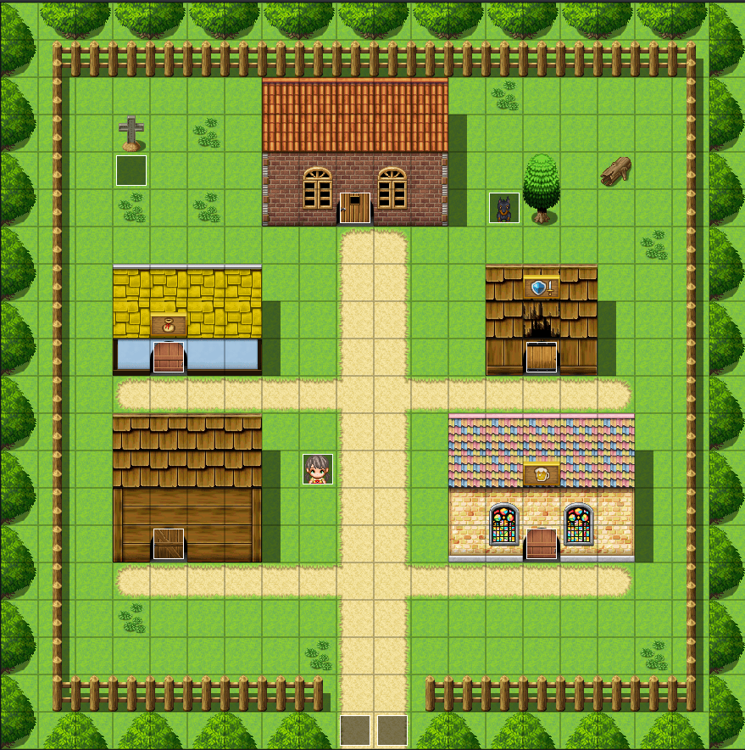
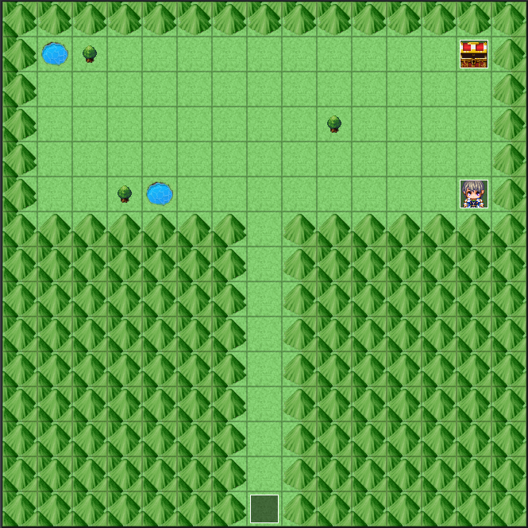
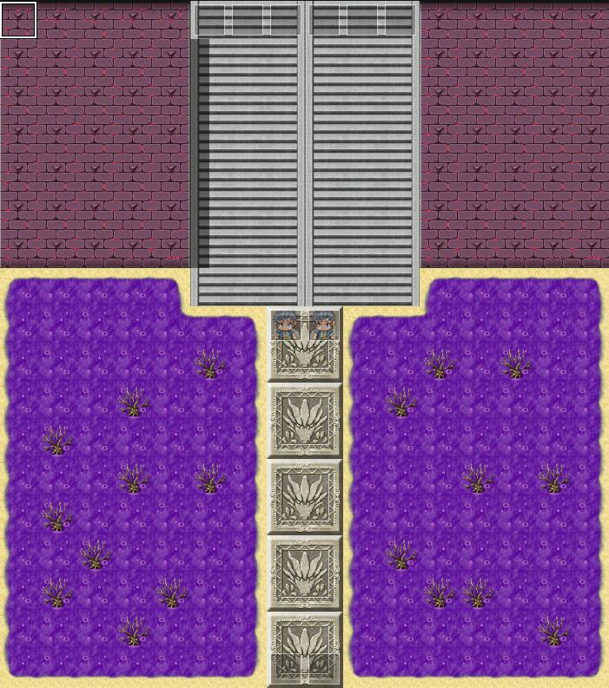
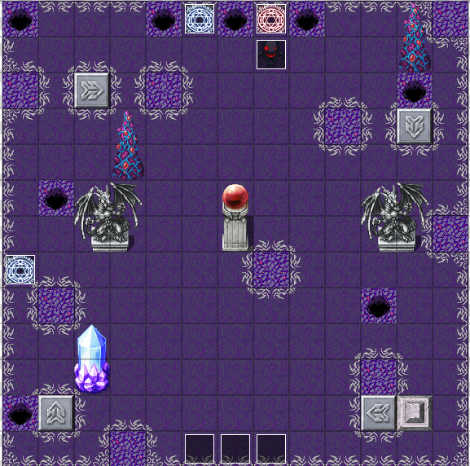
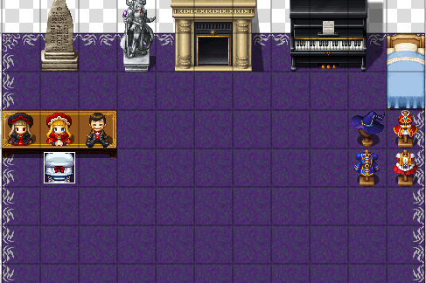
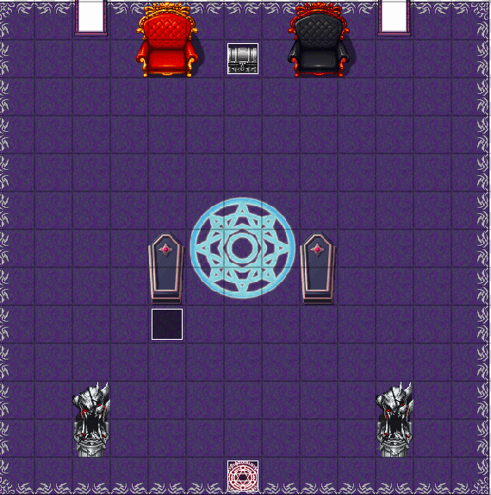
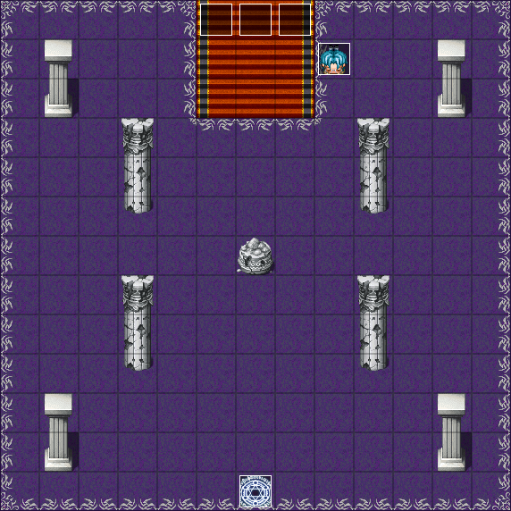
Chapters
3 chapters
Multiple maps per chapter
Bosses
Recruits party
Cutscenes and endings
Notes:
There is 3 main chapters. Each chapter has multiple maps and bosses. You can recruits party as you complete more chapters. There are many cutscenes and endings to support the transition of chapters.

Slide 5
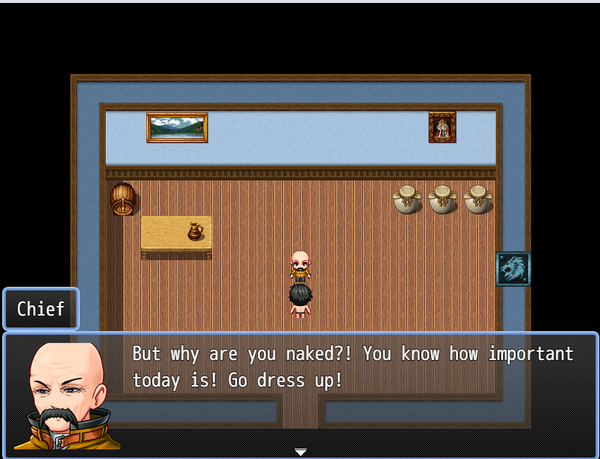
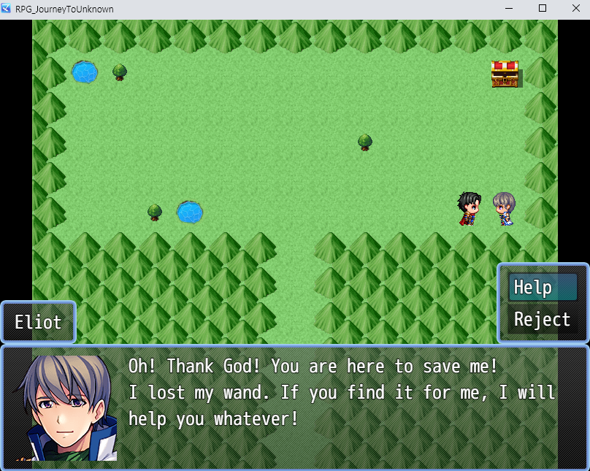
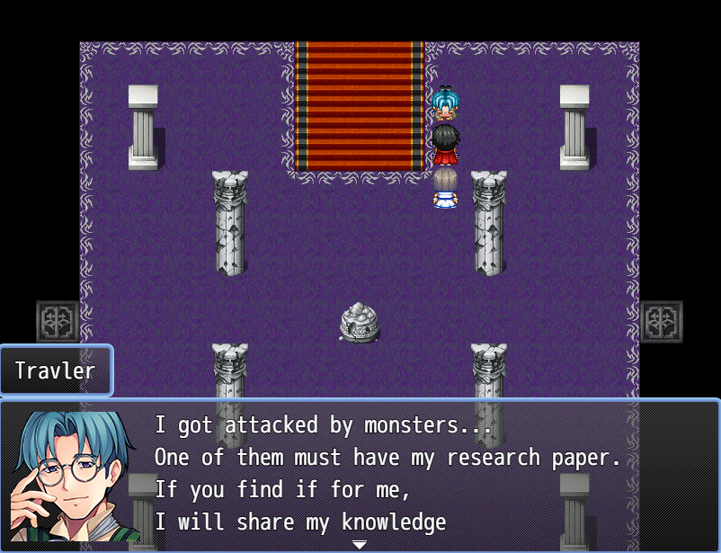
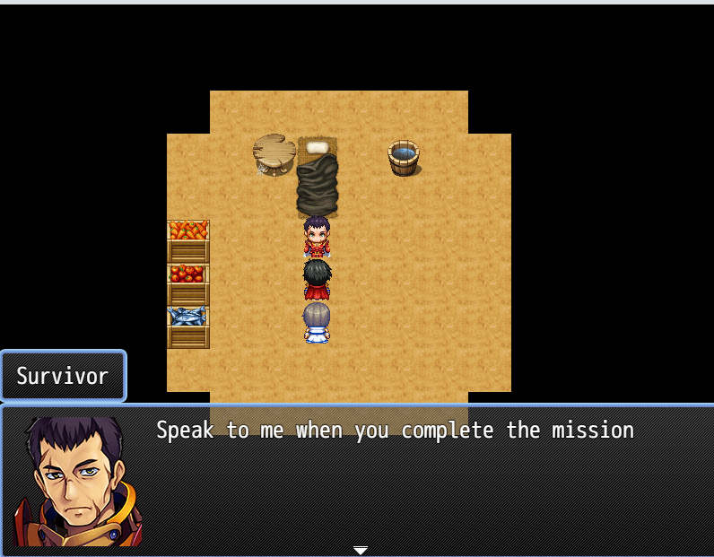
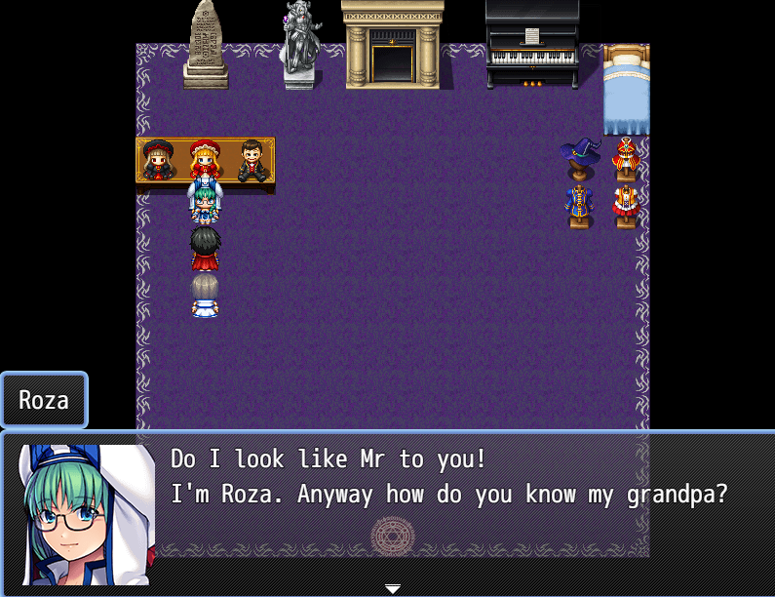
Main Party + Key Characters
Hero
SwordsMan
Priests
Unique Skills for Final Boss is Unlocked at certain level or condition
Recruits member each chapter
Notes:
Main party is consist of Hero, SwordsMan, and Priests. Each member of party can gain Unique skill designed to help player beat final boss if met certain conditions. There are also multiple key characters who do not joins the party but plays important role ingame.

Slide 6
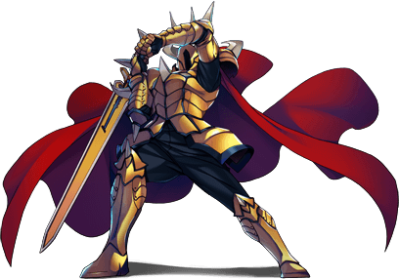
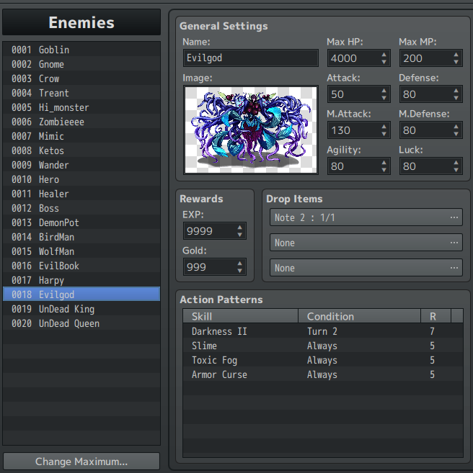
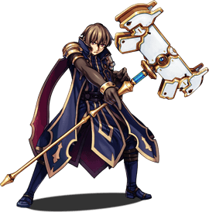
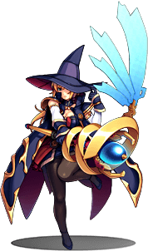
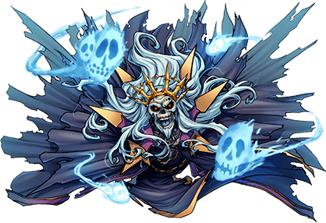
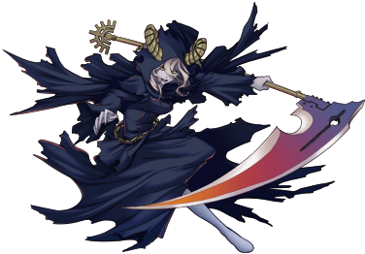
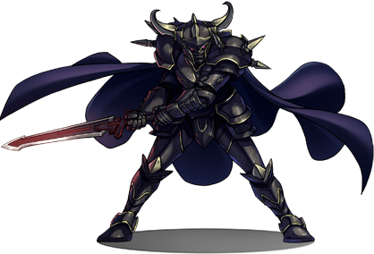
Mobs + Bosses
Multiple mobs with unique characteristics
e.g Demonpot nukes entire enemy ; Birdman has high speed ; Harpy attacks by singing
7+ main Bosses
Each Boss have unique characteristics
Different Bosses can be encountered depending on user choices
Change in difficulties depending on user choices
Notes:
There are multiple mobs with unique characteristics. There are 7 main bosses. Each boss have unique characteristics like Ketos have thick skins so have strong defends. Undead King and Queen steals life and etc. Different Bosses can be encountered depending on user choices and their difficulties will also vary.

Slide 7
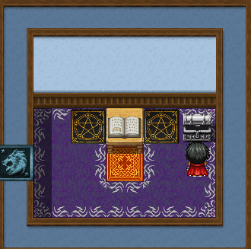
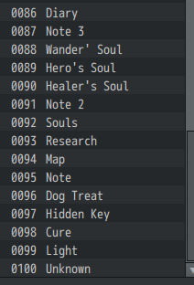
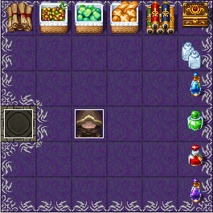
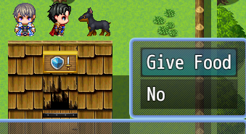
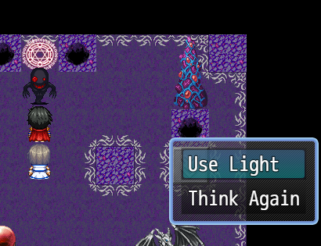
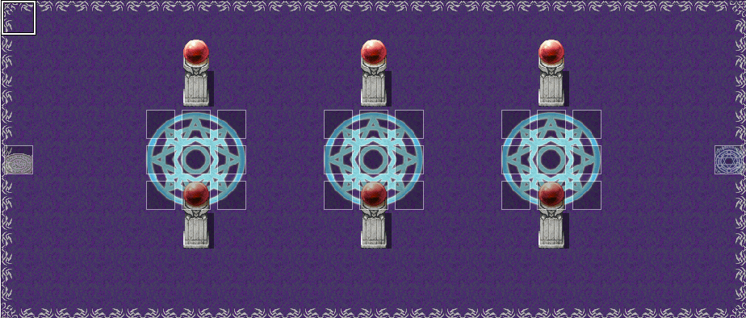
Hidden Items + Gimmick
User can choose to follow storyline without finding any hiddens
Discovering Hidden Items help understand mysteries of main story
Differents Gimmick is applied to prevent user to access them without trying
Easy if you know hard if don’t
Happy Ending can be achieved without finding all the hiddens however difficulties rise
Notes:
Hidden Items and Gimmick plays important role ingame. User can blindly follow quests and still beat the game but they will be left with many questions. By interacting with different npcs and objects, and solve gimmicks, user can find hidden items that gives hint on mysteries. Gimmicks, starting from utilizing ceratin items, beating certain boss, avoiding certain tiles are applied. This was to encourage user to adventure around the maps.

Slide 8
Credits
Modification of RPG Maker MZ
Most of assets, bgm, and effects are from RPG Maker MZ
I modified them in my taste to fit my game
Chat GPT
Help for creating images for some of mobs and ending scenes
Help for converting texts to more RPG like
Youtube Tutorial
LvL Up Design for learning basic tools of RPG Maker MZ
https://www.youtube.com/watch?v=RrBgN0BAMPI&list=PLcS6QL7fKwyas7voxuz6o9yM_EWwhK8eP
HP Bar Plugin from theoallen
https://github.com/theoallen/RMMZ/tree/master/Plugins
Previous Final Videos for reference
Notes:
Credits. Most of assets are from RPG Maker MZ. I modified them to fit my game ex) for bgm, I changed pitch to change theme and etc. I also used Chat GPT to create imgs for certain mob and ending scense as well as converting texts to more RPG like texts. I used HP Bar Plugin made by theoallen. Youtube Tutorial by LvL Up Design to learn basic tools of RPG Maker MZ. Finally I referenced previous semesters final videos for reference. Thank you for watching.

